Slide 1
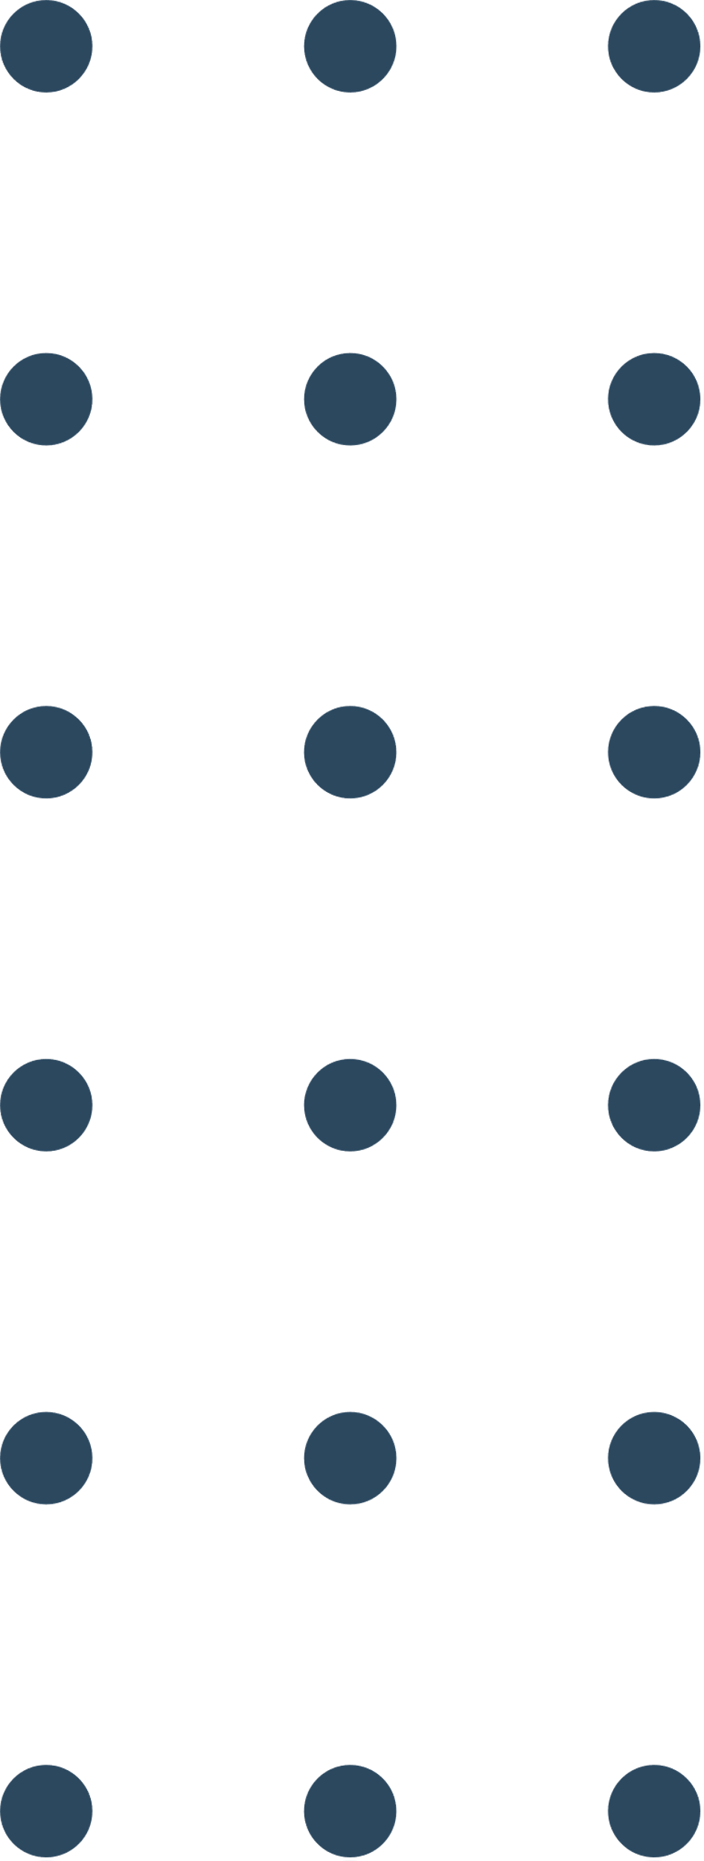

ASL To All Languages
Faculty of IT and CS-IS Department
Ahmed M Jarrah
Sewar M Qudah
Sura S Keelani
2nd Feb 2025

Slide 2

The Purpose of the Project
Bridging the communication gap between deaf and natural people by utilizing advanced Computer Vision techniques and cutting-edge models like MobileNet.

Slide 3
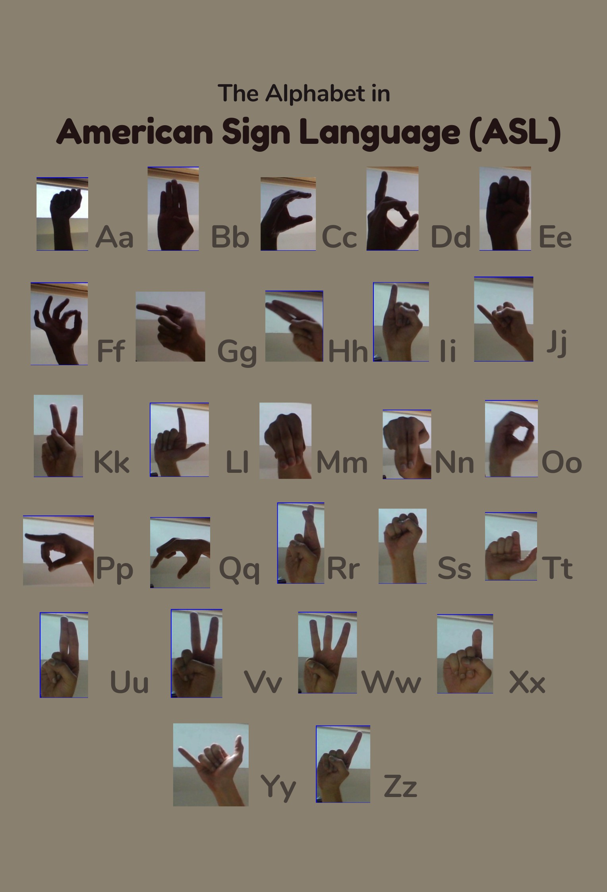
DATASET
collection of images of alphabets from the American Sign Language
29 classes, of which 26 are for the letters A-Z and 3 classes for SPACE, DELETE and NOTHING.
contains 87,000 images which are 200x200 pixels

Slide 4
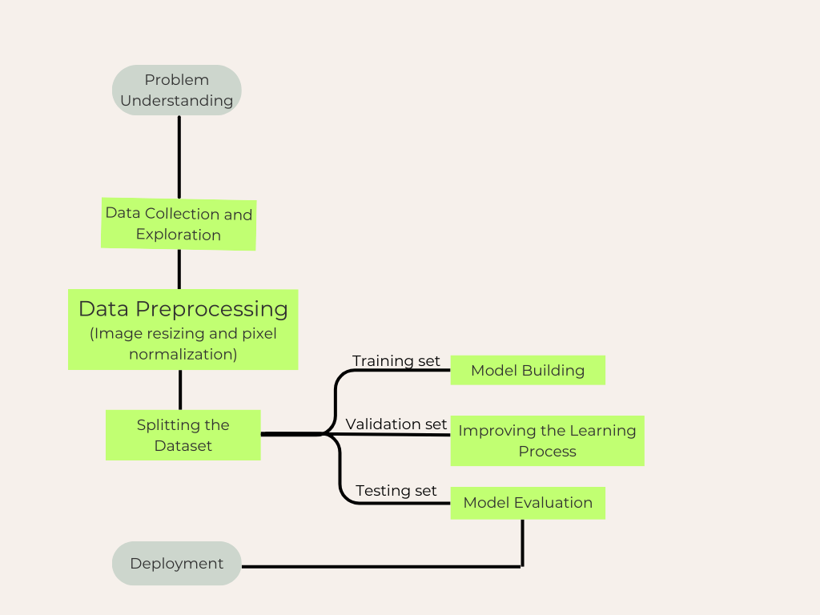
Our Methodology

Slide 5
The Models
Model | Why Selected!
Our CNN Model | Especially built for our task.
VGG16 Model | For its simplicity and depth. For its efficiency in feature extraction.
VGG19 Model | Chosen for its increased depth compared to VGG16, which can capture more complex features.
ResNet50 Model | Helps in training deeper networks by addressing the vanishing gradient problem.
MobileNet Model | Offering a lightweight model with relatively high accuracy.

Slide 6
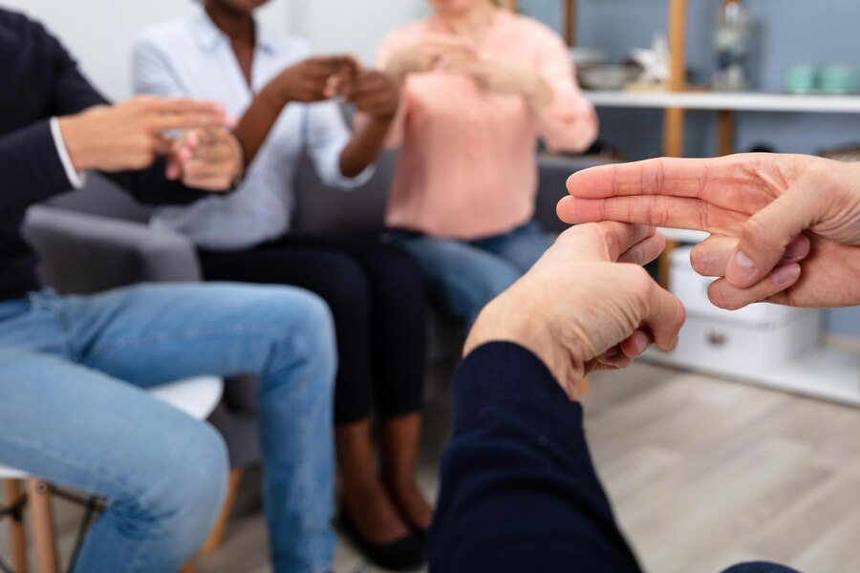
The Results
This project highlights the potential of deep learning in addressing communication barriers for the deaf community. By evaluating the models mentioned in the previous table, MobileNet proved the most effective, achieving 99.5% accuracy. We deployed our solution using Streamlit, creating a user-friendly and interactive web application.

Slide 7
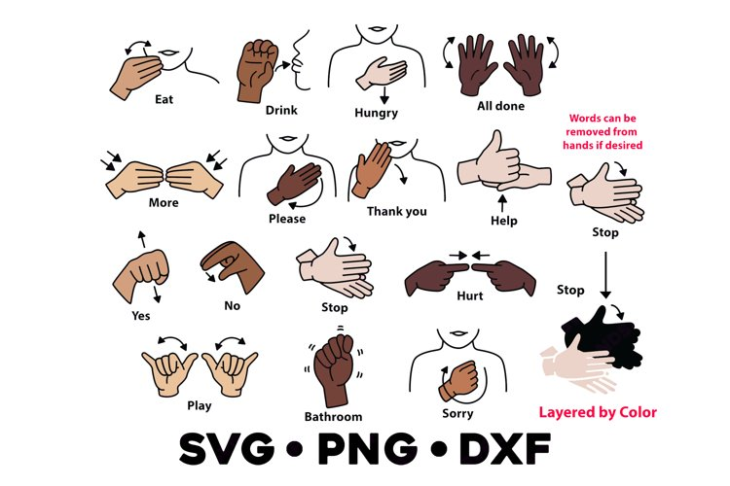
The Future Works
Expanding the platform to support multiple sign languages, increasing
accessibility and inclusiveness.
Multilingual Support
Developing a mobile application to enhance accessibility, allowing users to interact with the system anytime and anywhere.
Mobile Application Development
Real-time Application
Developing a system that utilizes a live video to capture and classify signs in real-time, enabling users to interact seamlessly and efficiently

Slide 8
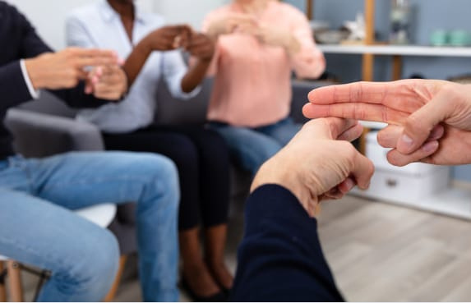
Thank You
for your attention

